Slide 1
Identifying statistically important eCSI drivers
July 2018

Slide 2
What drives customer satisfaction*?
This analysis sought to address the following questions:
Broadly: what features of a train ride make a customer more likely to report high satisfaction?
Do these results suggest direction for targeted action to raise satisfaction?
Are these features unique to individual routes? If so,
How significant are these differences?
Have these features changed over time?
Is there more variation over time or across routes?
*Note: overall satisfaction is defined as the average of the questions “Based on this trip, would you recommend traveling on Amtrak to a friend or business associate?” and “Overall, how satisfied were you with Amtrak based on this trip?”

Slide 3
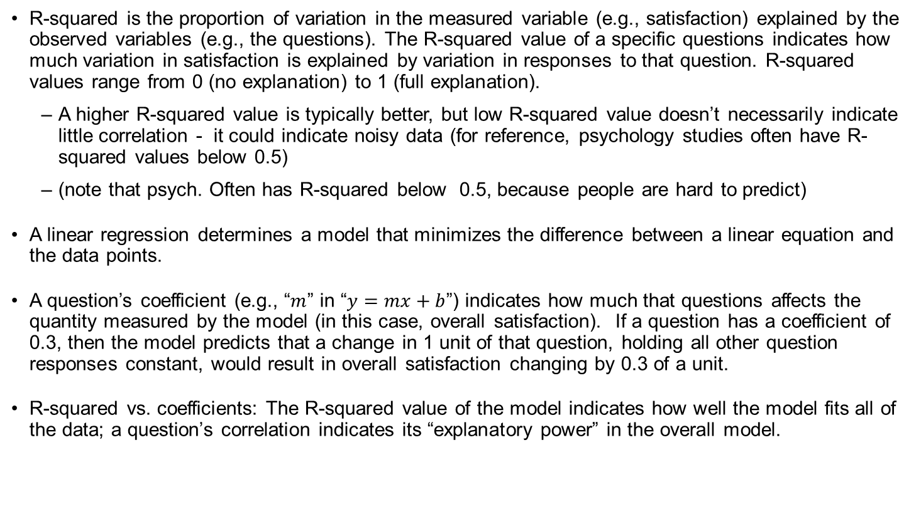
Stats backgrounder
R-squared is the proportion of variation in the measured variable (e.g., satisfaction) explained by the observed variables (e.g., the questions). The R-squared value of a specific questions indicates how much variation in satisfaction is explained by variation in responses to that question. R-squared values range from 0 (no explanation) to 1 (full explanation).
A higher R-squared value is typically better, but low R-squared value doesn’t necessarily indicate little correlation - it could indicate noisy data (for reference, psychology studies often have R-squared values below 0.5)
(note that psych. Often has R-squared below 0.5, because people are hard to predict)
A linear regression determines a model that minimizes the difference between a linear equation and the data points.
A question’s coefficient (e.g., “$m$” in “$y=mx+b$”) indicates how much that questions affects the quantity measured by the model (in this case, overall satisfaction). If a question has a coefficient of 0.3, then the model predicts that a change in 1 unit of that question, holding all other question responses constant, would result in overall satisfaction changing by 0.3 of a unit.
R-squared vs. coefficients: The R-squared value of the model indicates how well the model fits all of the data; a question’s correlation indicates its “explanatory power” in the overall model.

Slide 4
The model

Slide 5
Analytical method: the R program
The statistical programming language “R” was used to develop a model to analyze eCSI data, using the following process:
Begin with all eCSI data for the route to be analyzed, over the desired time frame
Run regressions of each individual eCSI question (e.g., cleanliness of the restrooms) against overall satisfaction; discard those with r-squared values below a threshold to eliminate statistically insignificant attributes
Of the remaining questions, run through all possible permutations of questions to find the best (highest adjusted r-squared value) fitting multivariate linear model
Use the resulting model to identify the top drivers of the overall eCSI score for each route, generate these results in an Excel sheet

Slide 6
Testing the model: Does the model predict actual eCSI results?
In order to test the model, predicted eCSI values (vertical axis) are plotted against reported eCSI values (horizontal axis). Values are predicted using survey values and the multivariable linear model generated by the R program.
Assumptions: Data is normally distributed, variance is normal, there is little collinearity, data has a linear relationship
For each route there was a similar relationship between the predicted values and reported values, as the following graphs show.

Slide 7
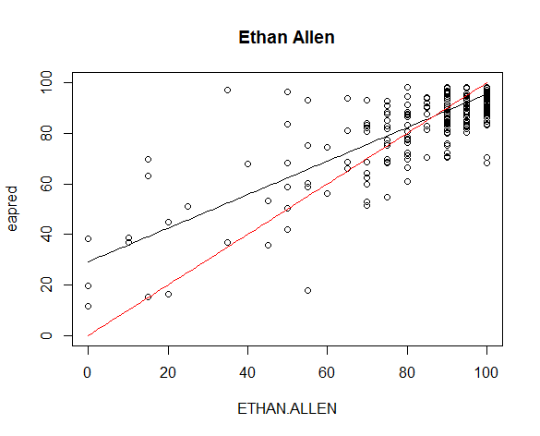
Ethan Allen
Coefficients:0.6633
(Intercept) 29.1713
Adjusted R squared value of model = 0.6576
How well the model predicts the data = 0.6621774

Slide 8
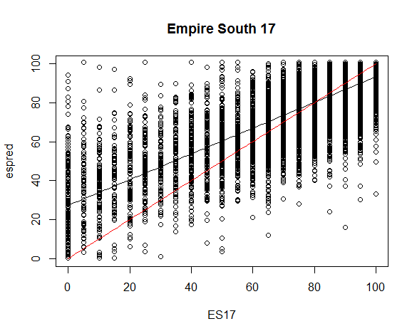
Empire South (2017)
Coefficients: 0.6605
(Intercept) 27.2554
Adjusted R squared value of model = 0.6753
How well the model predicts the data = 0.6645365

Slide 9
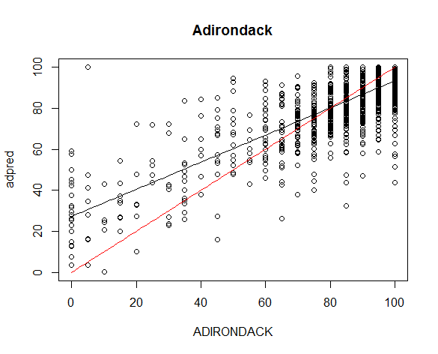
Adirondack
Coefficients: 0.649
(Intercept) 27.283
Adjusted R squared value of model = 0.7041
How well the model predicts the data = 0.6519285

Slide 10
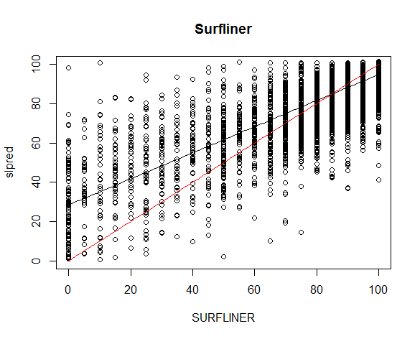
Surfliner
Coefficients: 0.6639
(Intercept) 28.4162
Adjusted R squared value of model = 0.6951
How well the model predicts the data = 0.679952

Slide 11
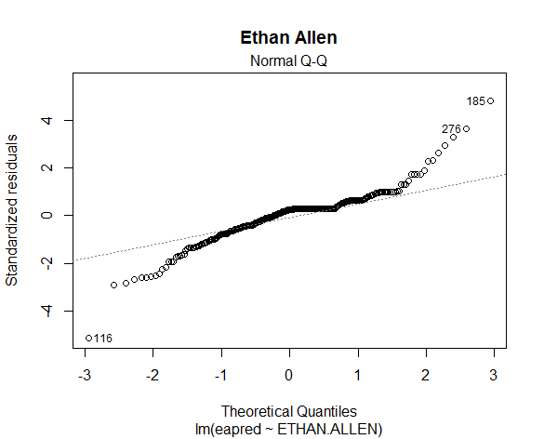
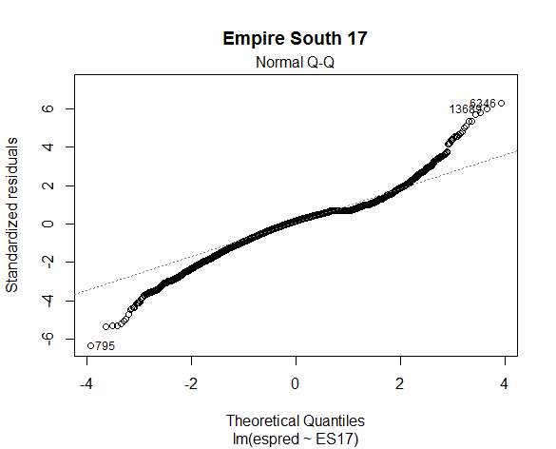
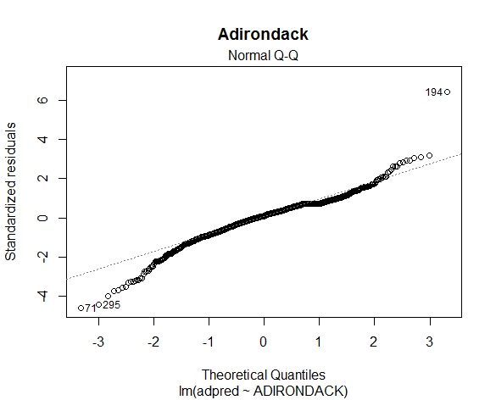
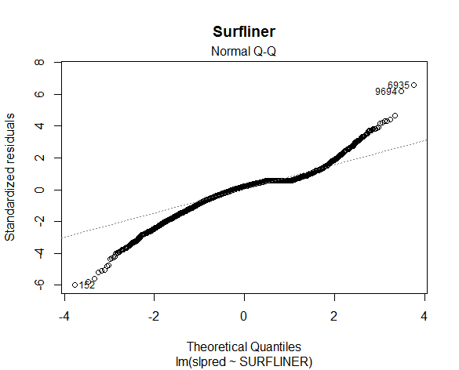
Additional test: Actual vs. theoretical residuals of fit
An additional test of the model compares the actual and theoretical residuals of fit. Ideally, points follow the dotted line.

Slide 12
Is the model good enough to use?
In all cases, the models overestimate the lower scores and slightly underestimate the higher scores.
This is likely because the data itself is significantly concentrated around high scores.
Because it fits most of the data well, we can reasonably use this data, but should be cautious of extreme values

Slide 13
results

Slide 14
The most important drivers for all NY routes
The results indicate the following drivers are most important determinants of the eCSI score for the State Supported routes in New York. The table shows the drivers in order of significance and the average correlation with the overall score for each route.
Driver | Count* | Average Correlation
Smooth and comfortable train ride | 19 | 0.283360255
Adirondack | 5 | 0.331604127
Empire West | 5 | 0.335613817
Ethan Allen | 5 | 0.217256174
Empire South | 4 | 0.240368564
Reliability or on-time performance of the train | 14 | 0.231647691
Empire West | 5 | 0.250532758
Adirondack | 5 | 0.222456411
Empire South | 3 | 0.208092023
Ethan Allen | 1 | 0.25384577
Amtrak's ability to get you to your destination safely | 7 | 0.259089441
Adirondack | 2 | 0.260789779
Empire West | 2 | 0.340473643
Ethan Allen | 2 | 0.194867699
Empire South | 1 | 0.221363844
Friendliness/helpfulness of the train conductors | 6 | 0.20639412
Empire South | 4 | 0.206785455
Empire West | 1 | 0.227120021
Adirondack | 1 | 0.184102875
Overall cleanliness of the train interior | 5 | 0.213772639
Ethan Allen | 3 | 0.223242565
Empire South | 1 | 0.197818516
Adirondack | 1 | 0.201316981
Accuracy of information received about the train trip prior to boarding the train | 2 | 0.153766855
Empire South | 2 | 0.153766855
Personal security on the train | 2 | 0.147679418
Ethan Allen | 2 | 0.147679418
Overall station experience at the boarding station | 1 | 0.130860725
Adirondack | 1 | 0.130860725
Information given about problems/delays while on the train | 1 | 0.161517612
Ethan Allen | 1 | 0.161517612
*Count is the number of times that driver shows up in a route’s yearly top 3 drivers between 2014-2018

Slide 15
Key takeaways: smooth/comfortable ride, OTP are most important
Smooth and comfortable ride is most important, with perceived OTP also very important.
Feelings of safety and conductor friendliness were also important, but less so.
These trends emerge clearly from looking at all the NY data together, but are generally true for individual routes.

Slide 16
Surprising questions that were NOT highly correlated…
The results indicate the following drivers are least important determinants of the eCSI score for the State Supported routes in New York.
The table shows the drivers in order of least significance.
Driver | Avg. R value
Smell of restrooms on the train pleasant/free of odor | 0.150306
Personal safety at boarding station | 0.16645
Ability to stay connected to Amtrak's Wi-Fi service | 0.180841
Time it takes to load/access websites, e-mails, email attachments | 0.184278
Ability to perform online activities that I want | 0.185891
Cleanliness of the restrooms on the train | 0.190316
Overall cleanliness of the boarding station | 0.190759
Ease of accessing Amtrak's Wi-Fi service (sign-on process) | 0.192802
Overall cleanliness of the destination station | 0.195499
Overall station experience at the destination station | 0.196606
Overall, how satisfied were you with the basic Wi-Fi service on the train? | 0.20187
Air temperature on the train | 0.207101
Clarity of information about connecting transportation services at destination station | 0.221562
Overall condition of the train platform and boarding area | 0.22658
Cleanliness of train windows | 0.228324

Slide 17
Key takeaways: overall cleanliness less important
Bathroom condition (smell, overall cleanliness) has very little correlation with overall satisfaction
Wifi speed, ease of connection, and overall experience is likewise not significantly correlated to satisfaction
Physical atmosphere on train (clean windows, air temperature) and at stations (cleanliness of boarding and destination stations, safety at boarding station, overall condition of platform and boarding areas) not significant for overall satisfaction

Slide 18
Case Study: Using the model* to explore significant eCSI variation on Empire South from December 2017 to January 2018
Empire South |  |  | Dec-17 |  |  | Jan-18 |  |  | Dec-17 - Jan-18 Score Change
Survey Question | Model Coefficient |  | Survey Response | Model Weight |  | Survey Response | Model Weight |  | ∆ (Dec - Jan) | % of monthly change
(Intercept) | -10.68935823
1010: Pre-boarding info accuracy | 0.14944 |  | 87.82 | 13.1 |  | 86.17 | 12.9 |  | -0.2 | 9%
1110: Boarding exp. | 0.14781 |  | 91.60 | 13.5 |  | 91.22 | 13.5 |  | -0.1 | 2%
2030: Smooth | 0.22465 |  | 87.21 | 19.6 |  | 84.18 | 18.9 |  | -0.7 | 24%
2050: Clean | 0.12048 |  | 86.29 | 10.4 |  | 83.66 | 10.1 |  | -0.3 | 11%
2100: Problem/ delay onboard info | 0.07464 |  | 81.76 | 6.1 |  | 75.11 | 5.6 |  | -0.5 | 17%
2120: OTP | 0.18540 |  | 86.49 | 16.0 |  | 82.25 | 15.2 |  | -0.8 | 27%
2130: Friendly | 0.20781 |  | 83.94 | 17.4 |  | 82.50 | 17.1 |  | -0.3 | 10%
Arrival delay (minutes) |  |  | 6.06 |  |  | 9.18
AVERAGE CSI SCORE |  |  | 86.71 | 85.54 |  | 82.09 | 82.66 |  | -2.9 | 100%
Variance to actual score ($) |  |  |  | 1.17 |  |  | +0.58
Variance to actual score (%) |  |  |  | -1.3% |  |  | 0.7%
*model generated using all Empire South survey data from July 2013 – April 2018

Slide 19
Case Study 2: Using the model to explore significant eCSI variation on Empire South from December 2017 to January 2018
Observe that all indicators are higher for December (CSI 86.71) than January (CSI 82.09)
Overall satisfaction is influenced most heavily by questions with high model coefficients
Differences between months come primarily from perceived OTP (27%), smooth and comfortable ride (24%), and onboard information about problems and delays (17%)

Slide 20
Model fitted to Empire South monthly CSI data (for significant questions only)
The model fits the monthly data well, with average variance of 0.64%
Question | Apr '17 | May '17 | Jun '17 | Jul '17 | Aug '17 | Sep '17 | Oct '17 | Nov '17 | Dec '17 | Jan' 18 | Feb '18 | Mar '18 | Apr '18 | Average
1010: Info | 88.56 | 87.37 | 91.15 | 88.54 | 90.40 | 90.95 | 90.21 | 91.01 | 87.82 | 86.17 | 90.90 | 89.96 | 86.05 | 89.16
1110: Boarding exp. | 91.58 | 90.09 | 91.49 | 91.17 | 92.41 | 92.12 | 91.40 | 92.07 | 91.60 | 91.22 | 91.53 | 90.76 | 92.35 | 91.52
2030: Smooth | 87.25 | 87.28 | 86.87 | 84.88 | 86.60 | 88.31 | 87.40 | 85.91 | 87.21 | 84.18 | 85.03 | 86.77 | 86.71 | 86.49
2050: Clean | 85.45 | 84.58 | 86.41 | 84.50 | 84.73 | 86.50 | 86.19 | 84.28 | 86.29 | 83.66 | 86.17 | 84.91 | 85.35 | 85.31
2100: Problem/ delay onboard info | 77.58 | 78.85 | 81.97 | 77.55 | 83.53 | 82.13 | 81.76 | 78.93 | 81.76 | 75.11 | 85.05 | 84.10 | 82.83 | 80.86
2120: OTP | 82.20 | 82.36 | 85.96 | 77.61 | 86.34 | 85.29 | 81.29 | 84.41 | 86.49 | 82.25 | 89.61 | 86.96 | 84.16 | 84.22
2130: Friendly | 84.82 | 83.60 | 87.16 | 82.67 | 84.41 | 86.73 | 84.53 | 84.17 | 83.94 | 82.50 | 84.00 | 82.40 | 79.38 | 83.87
Arrival Delay (minutes) | 10.42 | 8.44 | 6.80 | 14.11 | 8.85 | 10.19 | 9.52 | 8.06 | 6.06 | 9.18 | 1.11 | 3.76 | 6.58 | 7.93
Overall | 85.81 | 84.66 | 86.68 | 83.70 | 85.59 | 88.09 | 85.73 | 86.02 | 86.97 | 82.09 | 85.88 | 85.52 | 84.84 | 85.51
Model Prediction | 84.64 | 84.01 | 86.55 | 82.62 | 85.92 | 86.74 | 85.06 | 85.01 | 85.54 | 82.66 | 86.33 | 85.42 | 83.86 | 84.95
Variance to actual score ($) | 1.18 | 0.65 | 0.12 | 1.07 | (0.33) | 1.35 | 0.67 | 1.01 | 1.43 | (0.58) | (0.44) | 0.11 | 0.98 | 0.56
Variance to actual score (%) | 1.4% | 0.8% | 0.1% | 1.3% | -0.4% | 1.5% | 0.8% | 1.2% | 1.6% | -0.7% | -0.5% | 0.1% | 1.2% | 0.64%

Slide 21
Conclusions

Slide 22
Returning to original questions…
Broadly: 1) Smooth and comfortable ride and 2) on-time performance (in that order) are by far the most important indicators of high CSI. 3) Amtrak’s ability to get you to your destination safely and 4) Friendliness/ helpfulness of train conductors, were also significant. This is not surprising.
1) and 2) are difficult to address, although Amtrak continually does so. There is more opportunity for staff to promote a feeling of onboard safety and friendliness, and these results indicate that would be important.
For NY routes, variation between years was roughly similar to variation between routes, suggesting that the differences are not unique to specific routes/ times, but rather come from a random distribution of the features that universally affect CSI.
Addressing issues like 1-4 above are more important for customer satisfaction than improving the cleanliness of the boarding and destination stations, the restrooms, and the train windows or improving the wifi..

Slide 23
Future questions and directions
Are the responses similar for trains with exceptionally high or low satisfaction? Or trains with known poor performance on a specific indicator (ex. Illinis Saluki train is known to have terrible OTP – does that not matter as much to its riders?)
NY and California trains are built around major cities – are the factors different for long-distance trains, or trains that largely connect rural communities?
The example of Empire South suggests that this model is successful at predicting overall satisfaction based on question scores – could explore the effect of changing specific question scores on overall satisfaction in the model.

Slide 24
Appendix

Slide 25
Appendix A: Question names and numbers
1010 | Accuracy of information received about the train trip prior to boarding | 2110 | Clarity of announcements on the train
1020 | Friendliness/helpfulness of station personnel at boarding station | 2120 | Reliability or on-time performance of the train
1060 | Clarity of station signage/announcements at boarding station | 2124 | Personal security on the train
1070 | Personal safety at boarding station | 2126 | Amtrak's ability to get you to your destination safely
1080 | Ease of train boarding process | 2410 | Did you use Amtrak's Wi-Fi service (AmtrakConnect) during your train trip? (section skipped if 'no')
1090 | Overall cleanliness of the boarding station | 2420 | Overall, how satisfied were you with the basic Wi-Fi service on the train?
1100 | Overall condition of the train platform and boarding area | 2430 | Ease of accessing Amtrak's Wi-Fi service (sign-on process)
1110 | Overall station experience at the boarding station | 2440 | Ability to perform online activities that I want
2030 | Smooth and comfortable train ride | 2450 | Ability to stay connected to Amtrak's Wi-Fi service
2040 | Air temperature on the train | 2460 | Time it takes to load/access websites, e-mails, email attachments
2050 | Overall cleanliness of the train interior | 3010 | Overall cleanliness of the destination station
2060 | Cleanliness of train windows | 3020 | Availability of information about connecting transportation services at destination station
2070 | Cleanliness of the restrooms on the train | 3030 | Clarity of information about connecting transportation services at destination station
2080 | Smell of restrooms on the train pleasant/free of odor | 3040 | Overall station experience at the destination station
2090 | Information given on the train about services/features/safety | 4030 | Value of Amtrak service received for the price paid for the trip
2100 | Information given about problems/delays while on the train

Slide 26
Appendix B: Average NY eCSI scores ranked by count, with correlation
Question | Count | Avg. Correlation | Avg. Value
Smooth and comfortable train ride | 19 | 0.28336 | 85.05345
Reliability or on-time performance of the train | 14 | 0.231648 | 78.93488
Amtrak's ability to get you to your destination safely | 7 | 0.259089 | 91.8151
Friendliness/helpfulness of the train conductors | 6 | 0.206394 | 87.98272
Overall cleanliness of the train interior | 5 | 0.213773 | 83.15943
Total |  |  | 83.96634

Slide 27
Appendix C: r-squared values vs. correlation

